Slide 1
《沿途有你共往》 教學資源
圖像來源：所有圖像均為創作共用授權

Slide 2
1.1 Happy face Sad face 面面不同

Slide 3
1.2 Don’t clap this one back 不要重複這個節奏

Slide 4
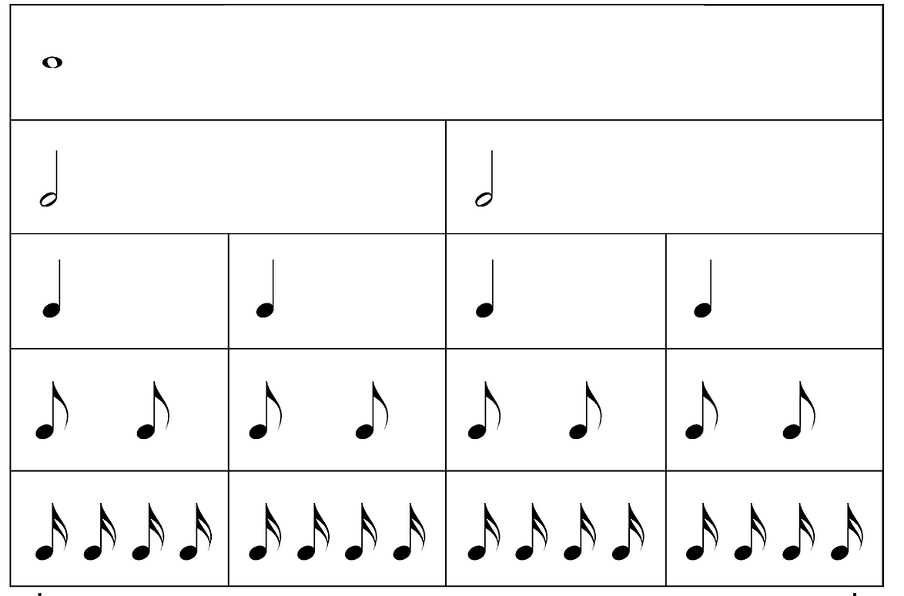
1.2 4/4 Time 4/4拍節奏

Slide 5
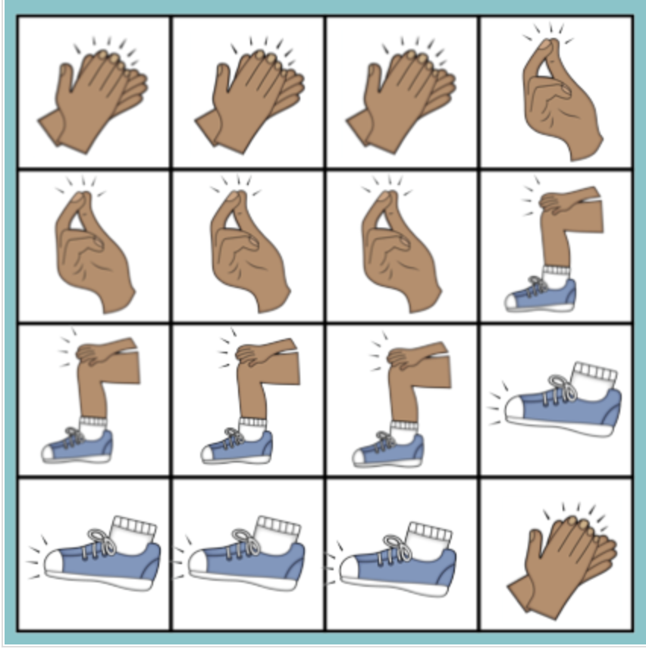
1.2 Body Percussion 身體敲擊例子
Free resources from Tri Borough Music Hub

Slide 6
1.3 Act it out 聚光燈下朗讀歌詞

Slide 7
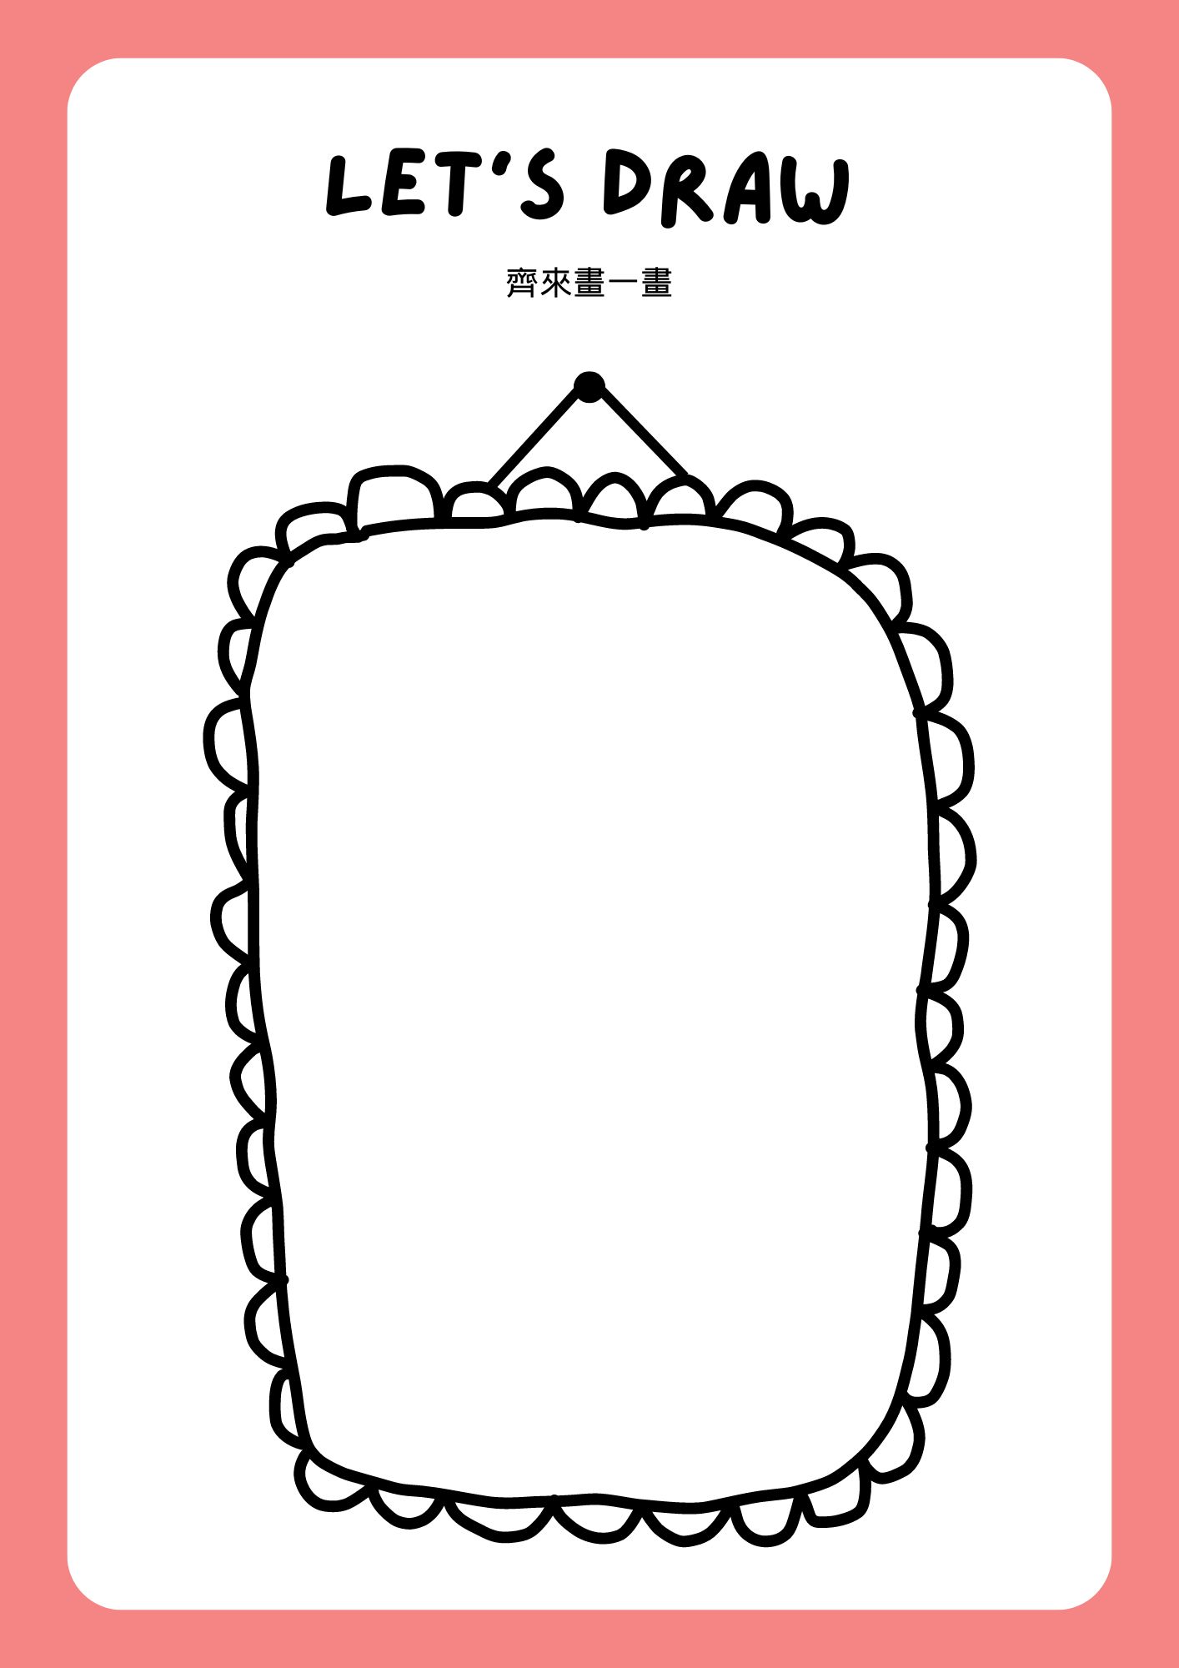
1.4 Let’s Draw 齊來畫一畫

Slide 8
Let’s Pray 齊來禱告

Slide 9
2.1 Blowing out candles 吹熄蠟燭

Slide 10
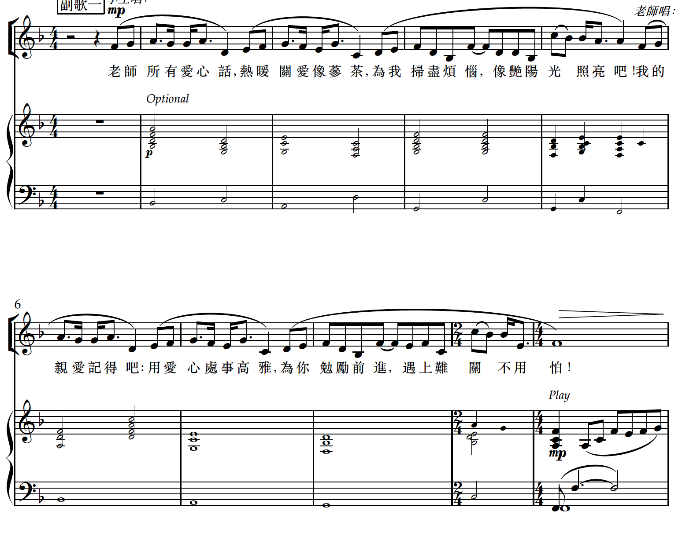
2.2 Breathe in/ Breathe out 吸氣 / 呼氣

Slide 11
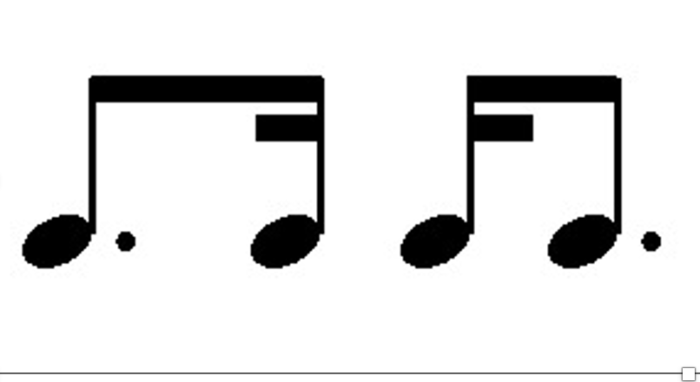
2.3 Dotted Dotty Improvisation 附點節奏即興練習

Slide 12
Now write up your message in the Thank you card and give it to the person you are thanking!
現在將您的感謝卡內容寫好，並送給您要感謝的人！

Slide 13
Well done you! You’ve done a lovely thing and made someone’s day.
How does that make you feel?

